Slide 1

Web App QA Automation Demo
Sergey Pogodin
December, 2014

Slide 2
Agenda
Project goal
Solution
Technical details
Comparison with other technologies
System diagram
Links / How to run

Slide 3
Project Goal
Show one of the most optimal solution for the moment to Automate Test scenarios for Web application

Slide 4
Solution
Selenium Webdriver (cross-platform tool for automation testing)
Page object and page factory patterns for WebDriver
Cucumber (library for tests execution, written in Gherkin language)
XSLT transformation (transformation of xml report into html format)
Log4j (library for logging)

Slide 5

Technical Details
Selenium
Universal cross-platform and cross-language solution for Web (including HTML5), Mobile and Desktop automation
Industry standard for Web Automation
Reusable modules as PageObject, Actions, Factories, data processing, object handling utilities, etc.
Easy to implement data-driven tests
Ability to use huge variety of 3rd party libs and tools due to support of most popular programming languages
Easy integration with CI
Explicit wait by certain event and configurable Implicit wait

Slide 6
Page object and Page factory
Clear separation between test code and navigation code in code base
Makes tests more readable
Ease of maintenance, when UI changes you need to change the navigation code and not test (provided application logic is still the same and only UI object/navigation is changed)
Just looking into the method name gives you all idea about the capabilities of the method
Easy creation of new tests. In fact, tests can be created by a person not knowing the features of automation tools
Good support of tests, because everything is stored in one place
Cons:
Initial design of page object might take more time
All locators should be kept in page class file

Slide 7

Supports Gherkin language to define steps which makes it easy and natural to create specification
Supports many languages and platforms
Steps are reusable across whole tested applications
Generates HTML and JSON reports
Steps are easy to understand for all and easy to parse by automation

Slide 8
XSLT transformation
XSLT applies user defined transformations to an XML document and the output can be HTML, XML, or any other structured document. So it is easy to merge XML data into presentation
By separating data (XML document) from the presentation (XSLT), it is very easy to change the output format in any time easily without touching the code-behind
XSLT templates are based on XPath pattern which is very powerful in terms of performance to process the XML document
XML is platform independent
XML has column flexibility, so it can be updated easily rather than a traditional table-row-column approach
It’s easy to build a well formatted report using XSLT transformation from XML into HTML
Cons:
It is difficult to implement complicate business rules in XSLT
Using XSLT have performance penalty in some cases as its engine don’t optimize code by using caching technique like traditional compiler
XML encourage non-relational data structure(de-normalized)

Slide 9

Log4J
Inserting log statements into code is a low-tech method for debugging it. It may also be the only way because debuggers are not always available or applicable
It provides precise context about a run of the application
Has an ability to disable certain log statements while allowing others to print unhindered
Log statements can be controlled with configuration files
Using a logger hierarchy it is possible to control which log statements are output at arbitrary granularity
Cons:
Logging can slow down an application

Slide 10

Comparison with other technologies
Watir vs Selenium WebDriver
Similarities:
Both are open source
Both support browsers only
Both can be integrated with BDD frameworks
Watir advantages:
Ruby is very simple and easy Language
It’s easy to build a well formatted report using XSLT transformation from XML into HTML
Watir has been traditionally had more functionality than Selenium, because it was designed to interact directly with IE instead of using JavaScript
Watir disadvantages:
Less help will be available online, as users are quite smaller in number
Ruby gems are limited for any type of integration
Selenium supports more browsers and operating systems

Slide 11
Cucumber vs TestNG
Cucumber | TestNG
Cucumber is a collaboration tool, which lets non-technical people write executable specifications. Those executable specifications test your app from the outside - like a black box. Cucumber is not meant to be used as a unit testing tool. It allows to write automated acceptance tests, functional requirements and software documentation into one format that would be understandable by non-technical people as well as testing tools Tests can be implemented using the same language you use to discuss them with the business. Cucumber adds the overhead of plain English (or other native language) to executable code conversion Good for acceptance testing | TestNG are unit testing tools. They are great for testing individual classes, but not great for executable specifications that are readable (and writeable) by non-technical people. It facilitates to test individual classes. You can group tests using tags. TestNG supports a lot of complicated practices like priorities, grouping, listener etc. Useful when you have to automate large number of test case Has an ability to run tests in parallel Supports different data providers such as Excel, DB, text files

Slide 12
Cucumber reports vs ReportNG
Cucumber reports and XSLT | ReportNG
Report shows separately each scenario Easy to customize XML has column flexibility, so it can be updated easily rather than a traditional table-row-column approach Optional comments can be added to each step Cucumber has it’s own reporter in different formats: XML, HTML, JSON Scenarios in report are in the same format as in the feature description Generates only single file and can be easily sent automatically by email Uses listeners. So, no additional code should be used in each test | Is a simple HTML reporting plug-in for the TestNG unit-testing framework Provides a simple, colour-coded view of the test results Generates 100% valid XHTML 1.0 files. The output can be customised by over-riding the default stylesheet with your own CSS file The ReportNG implementation maps each test class to a single <testsuite> element, resulting in one XML file per test class Includes a second reporter that produces JUnit format XML output. This enables TestNG to integrate with tools, such as Hudson, that understand these XML files

Slide 13
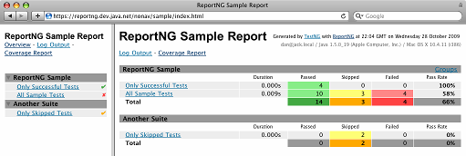
Report samples
ReportNG:

Slide 14
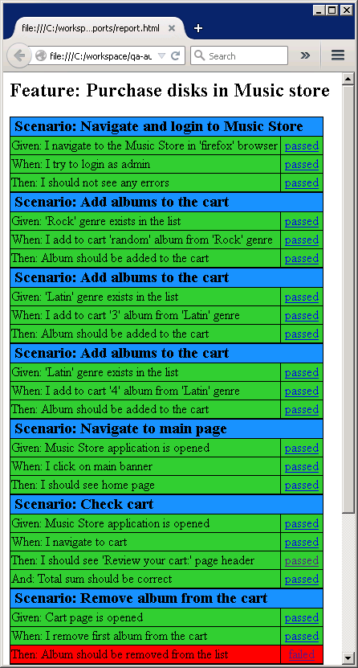
Cucumber and XSLT:

Slide 15





System diagram
Web server
Application
Browser
Code
GitHub
Test
Code
Libraries
Feature
Maven
XSLT
JUnit

Slide 16
Links, how to run
Links:
Eclipse - https://eclipse.org/downloads/
Maven plugin for eclipse - http://eclipse.org/m2e/
Git - http://git-scm.com/downloads
Source code for demo - https://git.lohika.com/qa-automation/qa-automation-demo/tree/master/WebDriver
How to run automation demo:
Install IIS server, Git, Eclipse and Maven plugin
Download all git repositories using link for demo
Deploy MvcMusicStore application on IIS server
Import framework and WebDriverAutomation projects into Eclipse
Run MusicStoreTestRunner.java from WebDriverAutomation project, automation.test package
Check results and report.html in {path_to_workspace}\WebDriverAutomation\test-output\cucumberreports directory

